Slide 1
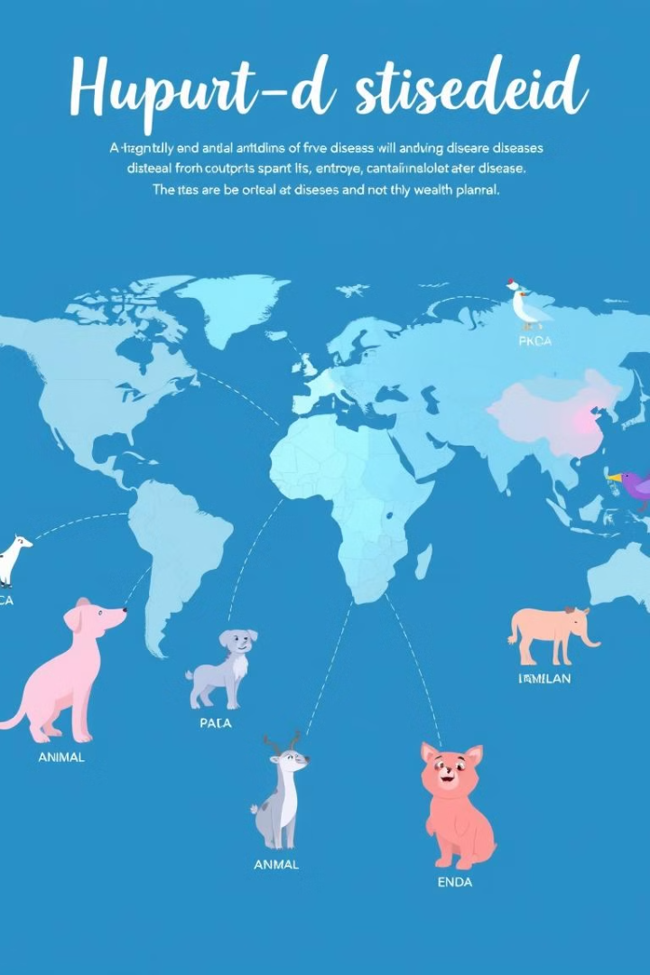
Disease Outbreaks Prediction and Analysis
Predicting disease outbreaks is crucial for proactive public health interventions. This project uses time series analysis and classification models to forecast and categorize centers for Zika and Hepatitis E spread.
Rhythm Gupta
Shlok Chawla

Slide 2
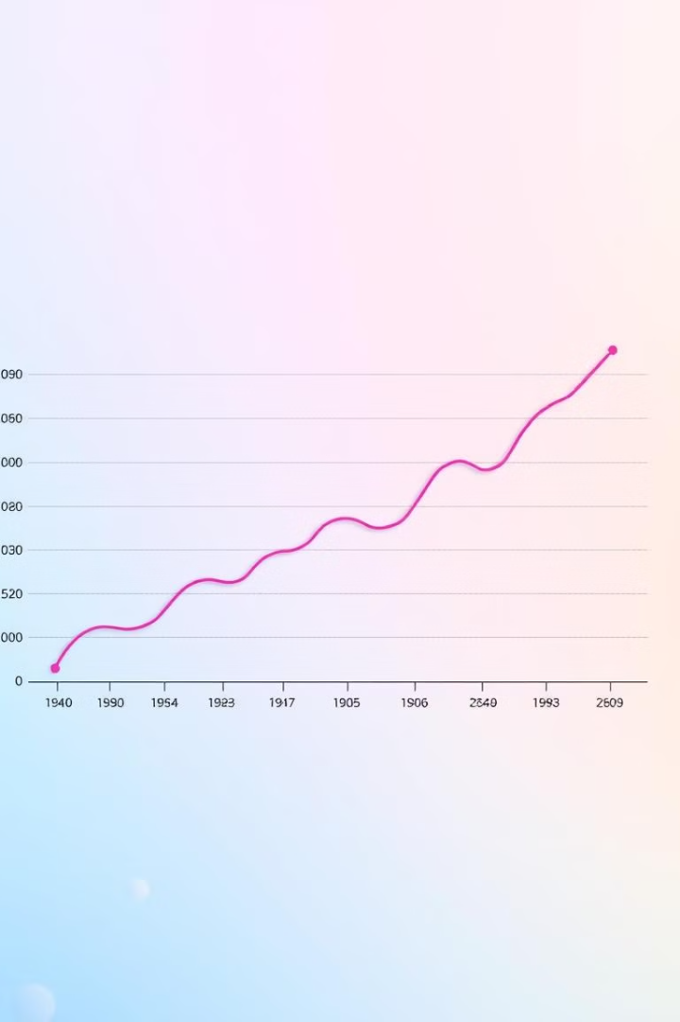


Introduction
1
Project Focus
Predicting disease outbreaks using time-series analysis and classification, focusing on Zika and Hepatitis E.
2
Methodology
Employs ARIMA, Prophet, LSTM, Decision Trees, Random Forest, and Neural Networks.
3
Objective
Categorize countries into risk levels based on healthcare infrastructure, socio-economic factors, and news.

Slide 3

Data Collection and Parameters
Data Sources
Medical Parameters
Socio-Economic Metrics
WHO's Disease Outbreak News, Coronavirus Dashboard, Statista, and scraped news headlines.
Hospital bed density, ICU availability, healthcare expenditure, and other relevant healthcare metrics.
Population density, GDP per capita, access to sanitation, and other socio-economic indicators.

Slide 4

Time Series Forecasting
1
ARIMA
Captures autocorrelations in time series data for short-term predictions.
2
Prophet
Handles seasonality and trend changes for more robust long-term forecasting.
3
LSTM
Learns long-term dependencies in sequential data for complex outbreak patterns.

Slide 5

Classification and Risk Categorization
Haversine Function
Calculate great circle distance between two points on earth.
Elbow Curve
Method for improving accuracy and robustness in classification.
Clustering Methods
Use DBSCAN and K-means algorithm for identifying cluster centers.

Slide 6
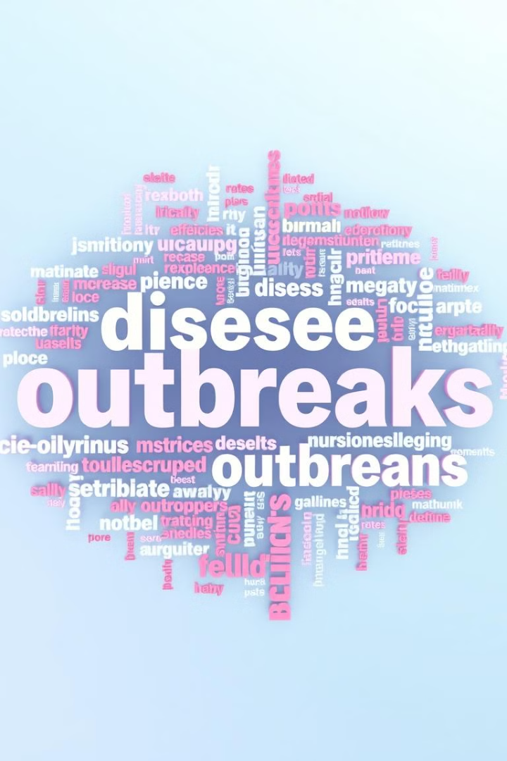



News Headline Analysis
Extraction
Extract headlines from text files obtained via Google Scraper.
Geo-identification
Identify countries and cities using GeonamesCache.
Normalization
Normalize and tokenize headlines for analysis.

Slide 7
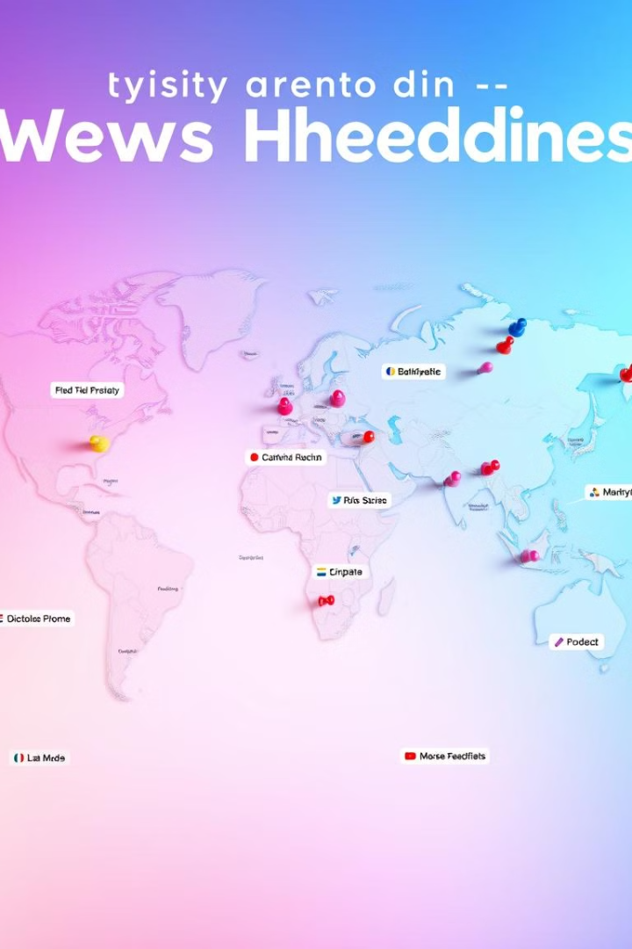



Geographic Data Integration
Geocoding
Use GeonamesCache to obtain latitude, longitude, and country codes.
Data Enrichment
Append geographic data to headlines for clustering.
Integration
Combine geographic data with other features for comprehensive analysis.

Slide 8
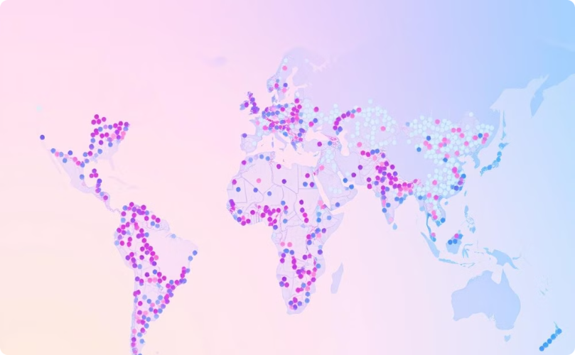
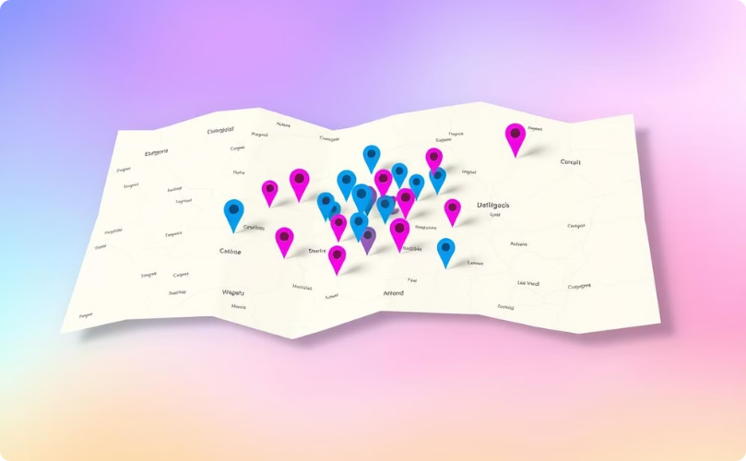



Clustering and Visualization
K-Means
DBSCAN
Partition data into distinct clusters based on geographic proximity.
Group data points based on density, handling outliers effectively.

Slide 9

Conclusion and Future Scope
Project Summary
Future Applications
Impact
Successfully predicts disease outbreaks using time series and classification.
Extend to other diseases and integrate more data for refined predictions.
Provides a versatile model for global health crisis management.

